Slide 1
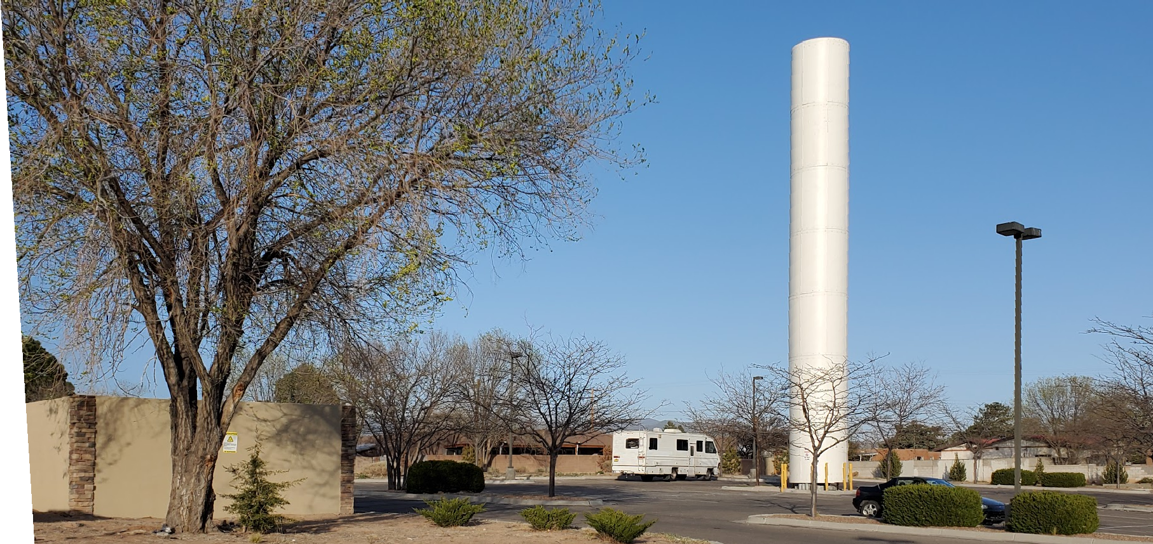
WTF? Wireless Telecommunication Facilities: The Boring Legal Stuff and the Fun Planning Stuff
Dr. Jonathan L. Kramer, Esq.
Telecom Law Firm, PC
NMAPA Conference
October 11, 2024
Catalina Lehner, AICP
City of Albuquerque
Notes:
Hi, my name is, I am the…..etc. Lot of different ways to go with this topic- could be focused on technical aspects, or tips for the local level, or what the Feds are doing, lease agreements, even site design, applications, and on and on. Approach I’ve taken, you’re a planner and you just found out you’re assigned to wireless…So, what do you need to know? For your entertainment, a few pics of my cats….

Slide 2
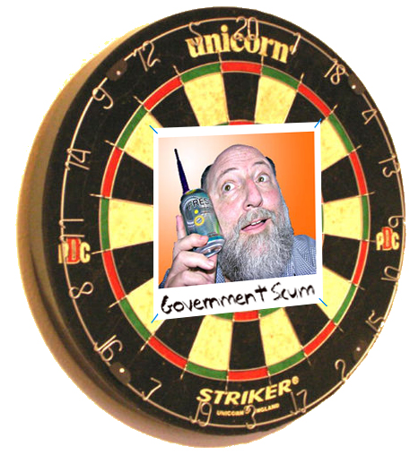
Telecom Law Firm, P.C. (Los Angeles & San Diego, CA) - Admitted to practice law in California and New Mexico - Licensed by FCC since early 70s (holds too many licenses/certs)
35+ years in telecommunications engineering (RF, broadband, fiber, outside plant safety, code compliance, RF safety)
30 years consulting on telecom matters > 800 governments/firms; 23 years of wireless siting and planning ~2,000 cases/matters
Expert witness/trial advisor in 40+ wireless, wired telecom cases
Co-author, Co-editor of FCC’s “A Local Government Official's Guide to Transmitting Antenna RF Emission Safety: Rules, Procedures, and Practical Guidance” (Currently revising for the FCC)
Member: NMML (Attorneys Section); IMLA; NATOA (Twice Member of the Year); Society of Broadcast Engineers (Senior Member); ARRL (Life Member); Society of Cable Telecommunication Engineers (UK; Fellow Member); Society of Cable Telecommunication Engineers (US; Senior Member Emeritus).
Education/Teaching:
LP.D Doctor of Law and Policy, Northeastern Univ., Boston
LL.M. with honors, Strathclyde University School of Law, Glasgow
JD cum laude, Abraham Lincoln School of Law, Los Angeles
Regulatory Law and Policy Instructor, Masters and Doctoral programs, Northeastern University, Boston and Seattle
Jonathan Kramer, Esq., J.D., LL.M, LP.D
Senior Partner
www.TelecomLawFirm.com
Direct Tel: (505) 490-6800

Slide 3
Catalina Lehner, AICP
Air Program Administrator & Division Manager, City of Albuquerque
Principal Planner/Team Lead, Senior Planner since 2005
Specializes in Analysis, Regulatory Applications, and Processes
AICP certified since 2001
Wireless Reviewer since 2006
Administers Wireless program
Reviews and decides:
New build wireless applications
Some collocations
Small Cells
Today’s focus: acronym explanation, and later- current trends, wireless applications…. THE FUN STUFF!

Slide 4
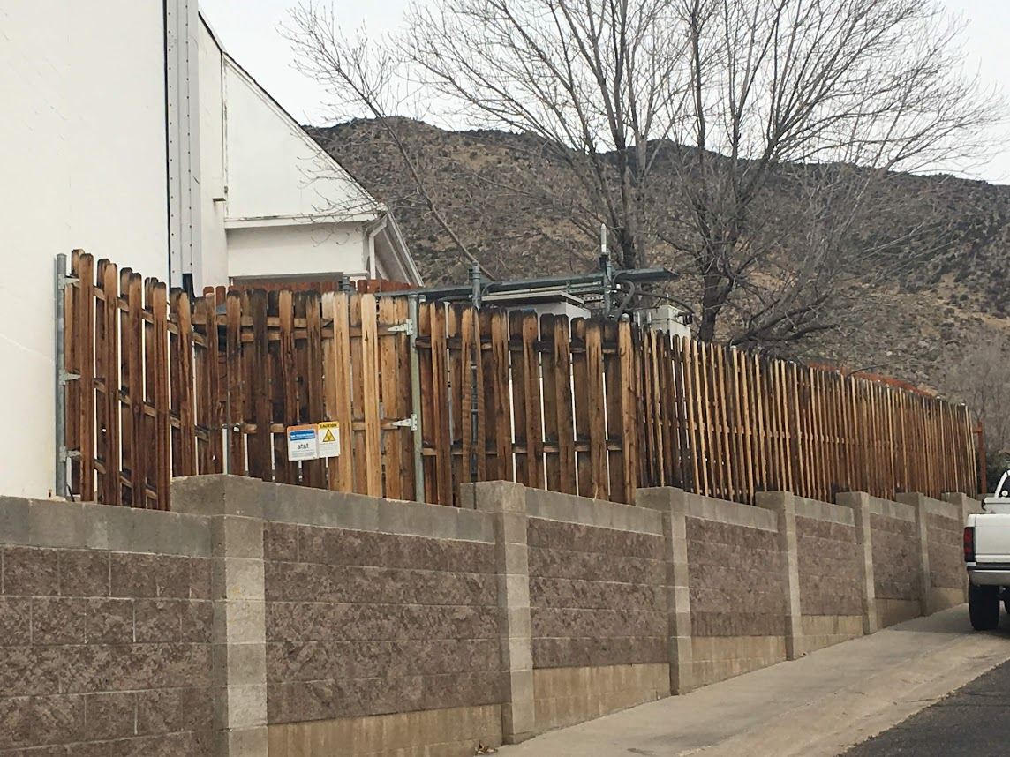
Guide: The local government as the permit agency Pesky federal laws and regulations Even more pesky state laws
Guide:
The local government as the permit agency
Pesky federal laws and regulations
Even more pesky state laws
Closing out: Special notes when the local government as the property owner

Slide 5
The Telecom Act: 47 U.S.C. 332(c)(7)
(7) Preservation of local zoning authority
(A) General authority Except as provided in this paragraph, nothing in this chapter shall limit or affect the authority of a State or local government or instrumentality thereof over decisions regarding the placement, construction, and modification of personal wireless service facilities.
(B) Limitations
The regulation of the placement, construction, and modification of personal wireless service facilities by any State or local government or instrumentality thereof—
(I) shall not unreasonably discriminate among providers of functionally equivalent services; and
(II) shall not prohibit or have the effect of prohibiting the provision of personal wireless services.
(ii) A State or local government or instrumentality thereof shall act on any request for authorization to place, construct, or modify personal wireless service facilities within a reasonable period of time after the request is duly filed with such government or instrumentality, taking into account the nature and scope of such request.
(iii) Any decision by a State or local government or instrumentality thereof to deny a request to place, construct, or modify personal wireless service facilities shall be in writing and supported by substantial evidence contained in a written record.
(iv) No State or local government or instrumentality thereof may regulate the placement, construction, and modification of personal wireless service facilities on the basis of the environmental effects of radio frequency emissions to the extent that such facilities comply with the Commission’s regulations concerning such emissions.
(v) Any person adversely affected by any final action or failure to act by a State or local government or any instrumentality thereof that is inconsistent with this subparagraph may, within 30 days after such action or failure to act, commence an action in any court of competent jurisdiction. The court shall hear and decide such action on an expedited basis. Any person adversely affected by an act or failure to act by a State or local government or any instrumentality thereof that is inconsistent with clause (iv) may petition the Commission for relief.

Slide 6
Section 6409(a) of the Middle Class Tax Relief and Job Creation Act of 2012 (47 U.S.C § 1455(a)) (47 CFR 1.6100)
Sec. 6409. WIRELESS FACILITIES DEPLOYMENT.
(a) Facility Modifications-
(1) IN GENERAL- Notwithstanding section 704 of the Telecommunications Act of 1996 (Public Law 104-104) or any other provision of law, a State or local government may not deny, and shall approve, any eligible facilities request for a modification of an existing wireless tower or base station that does not substantially change the physical dimensions of such tower or base station.
(2) ELIGIBLE FACILITIES REQUEST- For purposes of this subsection, the term ‘eligible facilities request’ means any request for modification of an existing wireless tower or base station that involves--
(A) collocation of new transmission equipment;
(B) removal of transmission equipment; or
(C) replacement of transmission equipment.
(3) APPLICABILITY OF ENVIRONMENTAL LAWS- Nothing in paragraph (1) shall be construed to relieve the Commission from the requirements of the National Historic Preservation Act or the National Environmental Policy Act of 1969.
Key: Does the Existing Site have a Legal Existence?
Can you understand the FCC’s hundreds of pages to explain 142 words above?

Slide 7
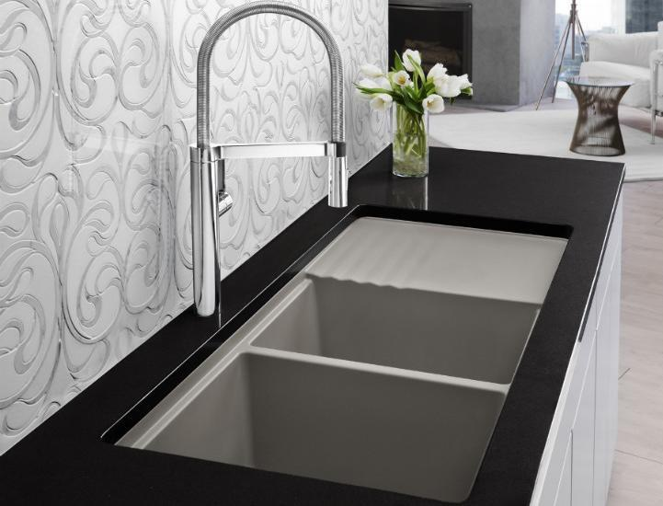
What can be colo’ed under 6409(a)?
Wi-Fi?
GMRS?
Broadcast?
SiriusXM Radio?
Ham?
Satellite?
Microwave?
Millimeter wave?
Any wireless service licensed by the FCC?
Any unlicensed wireless service permitted by the FCC?
<yes to all, if existing and legal existence, the add, change, or removal qualifies as a 6409(a) modification>
Hint

Slide 8
First Factual Question on EVERY 6409(a) project… Does the existing cell site really exist?
47 CFR § 1.61000(b)(5) “Existing. A constructed tower or base station is existing for purposes of [6409(a) analysis]if it [the cell base station and/or tower site, as it exists when the 6409(a)application is filed] has been reviewed and approved under the applicable zoning or siting process, or under another State or local regulatory review process, provided that a tower that has not been reviewed and approved because it was not in a zoned area when it was built, but was lawfully constructed, is existing for purposes of this definition.”
(TLF experience…40%+ of the existing cell sites have been modified without benefit of government permits…who knew?) (Magic Jumping Modifications followed by UnModifications!)

Slide 9
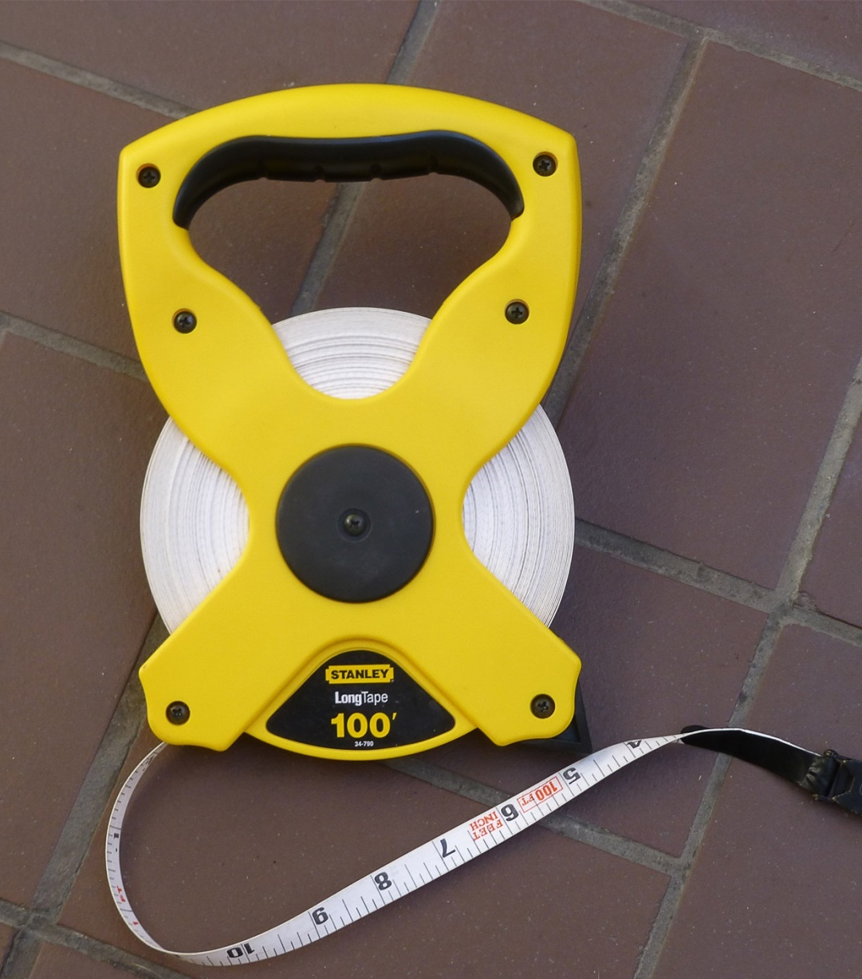
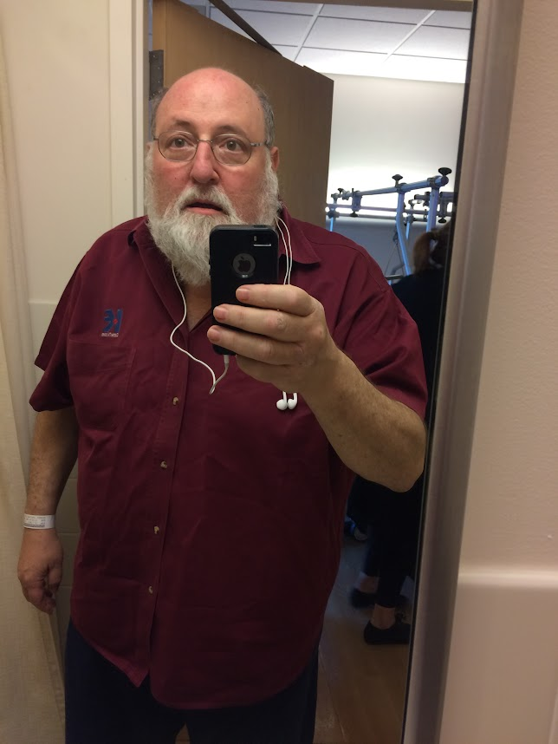
Money and time well spent…

Slide 10
What is(n’t) a Substantial Change?
§ 1.60001 Wireless Facility Modifications
(b)(7) Substantial change. A modification substantially changes the physical dimensions of an eligible support structure if it meets any of the following criteria:
(i) For towers other than towers in the public rights-of-way, it increases the height of the tower by more than 10% or by the height of one additional antenna array with separation from the nearest existing antenna not to exceed twenty feet, whichever is greater; for other eligible support structures, it increases the height of the structure by more than 10% or more than ten feet, whichever is greater;
(A) Changes in height should be measured from the original support structure in cases where deployments are or will be separated horizontally, such as on buildings' rooftops; in other circumstances, changes in height should be measured from the dimensions of the tower or base station, inclusive of originally approved appurtenances and any modifications that were approved prior to the passage of the Spectrum Act.
(ii) For towers other than towers in the public rights-of-way, it involves adding an appurtenance to the body of the tower that would protrude from the edge of the tower more than twenty feet, or more than the width of the tower structure at the level of the appurtenance, whichever is greater; for other eligible support structures, it involves adding an appurtenance to the body of the structure that would protrude from the edge of the structure by more than six feet;
(iii) For any eligible support structure, it involves installation of more than the standard number of new equipment cabinets for the technology involved, but not to exceed four cabinets; or, for towers in the public rights-of-way and base stations, it involves installation of any new equipment cabinets on the ground if there are no pre-existing ground cabinets associated with the structure, or else involves installation of ground cabinets that are more than 10% larger in height or overall volume than any other ground cabinets associated with the structure;
(iv) It entails any excavation or deployment outside of the current site, except that, for towers other than towers in the public rights-of-way, it entails any excavation or deployment of transmission equipment outside of the current site by more than 30 feet in any direction. The site boundary from which the 30 feet is measured excludes any access or utility easements currently related to the site;
(v) It would defeat the concealment elements of the eligible support structure; or
(vi) It does not comply with conditions associated with the siting approval of the construction or modification of the eligible support structure or base station equipment, provided however that this limitation does not apply to any modification that is non-compliant only in a manner that would not exceed the thresholds identified in § 1.40001(b)(7)(i) through (iv).

Slide 11
6409(a): Yes to the App(lication) No to the Map
When an applicant asserts in writing that a request for modification is covered by [Section 6409(a)], a State or local government may require the applicant to provide documentation or information only to the extent reasonably related to determining whether the request meets the requirements of [Section 6409(a)].
A State or local government may not require an applicant to submit any other documentation, including but not limited to documentation intended to illustrate the need for such wireless facilities or to justify the business decision to modify such wireless facilities.

Slide 12
6409 in the federal courts…
Three weeks ago, the 9th Circuit Court of Appeals released its decision in League of California Cities v FCC (Case No. 20-71765). The local governments won on some issues and did not win on some others (but note a dissent as to one of the points). Here are the highlights and lowlights: The decision, per curiam, is that the FCC’s: 1. limitations on concealment elements was invalid as an improper legislative rule; 2. restrictions on enforcement of conditions of approval related to concealment was invalid as an improper legislative rule; 3. reinterpretation for when the shot clock commences was not an invalid legislative rule (this was the subject of the dissent); 4. reinterpretation for height measurements and equipment cabinet definitions were not invalid legislative rules; and 5. requirement for express evidence of intent to impose concealment was not invalid as a retroactive rule.

Slide 13
Is the building a base station?

Slide 14
It’s a small, small, small , small cell site world
FCC’s September 2018 Small Cell Order
https://docs.fcc.gov/public/attachments/FCC-18-133A1.pdf
Lowlights:
State/local permit fees must be only to cover cost
‘Safe harbor’ for costs to process small cell applications…
$500 for up to first 1, plus $100 for each additional
…but jurisdiction can recover its reasonable costs.
Size limitations to bring a cell site into the small cell rules
More important: unlimited number of 3 cubic foot antennas
up to additional 28 cubic feet for cabinets;
New difficult aesthetic limitations on local govs (overturned in City of Portland v. United States, No. 18-72689 (9th Cir. 2020))
YASS (Yet another Shot Clock): 60 days for collocations of Small Wireless Facilities on existing structures (else deemed approved)

Slide 15
Section 63-9I-1 – Short Title. Cite NM Stat § 63-9I-1 (2021)
New Mexico’s “Wireless Consumer Advanced Infrastructure Investment Act".
This act [63-9I-1 to 63-9I-9 NMSA 1978] may be cited as the "Wireless Consumer Advanced Infrastructure Investment Act".

Slide 16
Section 63-9I-2 - Definitions. Cite NM Stat § 63-9I-2 (2021)
As used in the Wireless Consumer Advanced Infrastructure Investment Act:
A. "antenna" means communications equipment that transmits or receives electromagnetic radio frequency signals and that is used to provide wireless services;
B. "applicable codes" means uniform building, fire, electrical, plumbing or mechanical codes adopted by a recognized national code organization and enacted by the authority, including the local amendments to those codes enacted by the authority solely to address imminent threats of destruction of property or injury to persons, to the extent that those amendments are consistent with the Wireless Consumer Advanced Infrastructure Investment Act;
C. "applicant" means a wireless provider that submits an application;
D. "application" means a request submitted by an applicant to an authority for a permit to collocate one or more small wireless facilities or to approve the installation, modification or replacement of a utility pole or wireless support structure;
E. "authority" means a municipality or county;
F. "authority utility pole" means a utility pole, owned or operated by an authority, in a right of way;
G. "collocate" means to install, mount, maintain, modify, operate or replace one or more wireless facilities on, in or adjacent to a wireless support structure or utility pole;
H. "communications service" means cable service as defined in 47 U.S.C. Section 522(6), information service as defined in 47 U.S.C. Section 153(24), mobile service as defined in 47 U.S.C. Section 153(33), telecommunications service as defined in 47 U.S.C. Section 153(53) or wireless service other than mobile service;
I. "fee" means a one-time charge;
J. "law" includes federal, state or local law;

Slide 17
Section 63-9I-2 - Definitions. Cite NM Stat § 63-9I-2 (2021)
K. "permit" means the written permission of an authority for a wireless provider to install, mount, maintain, modify, operate or replace a utility pole or to collocate a small wireless facility on a utility pole or wireless support structure;
L. "person":
(1) means an individual, corporation, limited liability company, partnership, association, trust or other entity or organization; and
(2) includes an authority;
M. "private easement" means an easement or other real property right given for the benefit of the grantee of the easement and the grantee's successors and assigns;
N. "rate" means a recurring charge;
O. "right of way":
(1) means the area on, below or above a public roadway, highway, street, sidewalk, alley or utility easement; and
(2) does not include the area on, below or above:
(a) a federal interstate highway;
(b) a state highway or route under the jurisdiction of the department of transportation;
(c) a private easement; or
(d) a utility easement that does not authorize the deployment sought by a wireless provider;

Slide 18
Section 63-9I-2 - Definitions. Cite NM Stat § 63-9I-2 (2021)
P. "small wireless facility" means a wireless facility whose:
(1) antennas are, or could fit, inside an enclosure with a volume of six or fewer cubic feet; and
(2) other ground- or pole-mounted wireless equipment, not including the following, is twenty-eight or fewer cubic feet in volume:
(a) electric meter;
(b) concealment elements;
(c) telecommunications demarcation box;
(d) grounding equipment;
(e) power transfer switch;
(f) cutoff switch;
(g) vertical cable runs for the connection of power and other services; and
(h) elements required by an authority in accordance with Subsection H of Section 3 [63-9I-3 NMSA 1978] of the Wireless Consumer Advanced Infrastructure Investment Act;
Q. "utility pole":
(1) means a pole or similar structure used in whole or in part for communications services, electricity distribution, lighting or traffic signals; and
(2) does not include a wireless support structure or electric transmission structure;

Slide 19
Section 63-9I-2 - Definitions. Cite NM Stat § 63-9I-2 (2021)
R. "wireless facility":
(1) means equipment at a fixed location that enables wireless communications between user equipment and a communications network, including:
(a) equipment associated with wireless communications; and
(b) radio transceivers, antennas, coaxial or fiber-optic cables, regular and backup power supplies and comparable equipment, regardless of technological configuration;
(2) includes a small wireless facility; and
(3) does not include:
(a) the structure or improvements on, under or within which the equipment is collocated;
(b) a wireline backhaul facility, coaxial cable or fiber-optic cable between wireless support structures or utility poles; or
(c) coaxial or fiber-optic cable otherwise not immediately adjacent to, or directly associated with, an antenna;
S. "wireless infrastructure provider" means a person, other than a wireless services provider, that may provide telecommunications service in New Mexico and that builds or installs wireless communications transmission equipment, wireless facilities' utility poles or wireless support structures;
T. "wireless provider" means a wireless infrastructure provider or wireless services provider;

Slide 20
Section 63-9I-2 - Definitions. Cite NM Stat § 63-9I-2 (2021)
U. "wireless services" means services provided to the public that use licensed or unlicensed spectrum, either mobile or at a fixed location, through wireless facilities;
V. "wireless services provider" means a person that provides wireless services;
W. "wireless support structure" means a freestanding structure, including a monopole or guyed or self-supporting tower, but not including a utility pole; and
X. "wireline backhaul facility" means a facility used to transport services by wire from a wireless facility to a network.
<whew!>

Slide 21
Rest your eyes for a moment…

Slide 22
Section 63-9I-3 - Wireless provider; use of right of way; rates, fees and terms; right to access; damage and repair. Cite NM Stat § 63-9I-3 (2021)
A. This section applies to the activities of a wireless provider within a right of way.
B. An authority shall not enter into an exclusive agreement with a wireless provider for the use of a right of way in:
(1) constructing, installing, maintaining, modifying, operating or replacing a utility pole; or
(2) collocating a small wireless facility on a utility pole or wireless support structure.
C. An authority may charge a wireless provider a rate or fee for the provider's use of a right of way in constructing, installing, maintaining, modifying, operating or replacing a utility pole, or in collocating a small wireless facility, in the right of way only if:
(1) the authority otherwise may, under law, charge the rate or fee;
(2) the authority charges other communications service providers for their use, if any, of the right of way; and
(3) the rate or fee:
(a) is competitively neutral as compared to other users, if any, of the right of way, unless the other users are exempt under law from paying a rate or fee for their use of the right of way;
(b) is not in the form of a franchise or other fee based on revenue or customer counts;
(c) is reasonable and nondiscriminatory; and
(d) annually, does not exceed an amount equal to two hundred fifty dollars ($250) multiplied by the number of small wireless facilities placed by the wireless provider in the right of way and in the authority's jurisdiction.
D. An authority may adjust the rate it charges for the use of a right of way, but no more often than once a year and by no more than an amount equal to one-half the annual change, if any, in the most recent consumer price index for all urban consumers for New Mexico, as published by the United States department of labor. An authority that adjusts that rate shall notify all wireless providers charged the pre-adjusted rate of the prospective adjustment and shall make the adjustment effective sixty days or more following that notice.

Slide 23
Section 63-9I-3 - Wireless provider; use of right of way; rates, fees and terms; right to access; damage and repair. Cite NM Stat § 63-9I-3 (2021)
E. Except as otherwise provided in the Wireless Consumer Advanced Infrastructure Investment Act, and subject to the approval of an application as provided in Section 4 of that act [63-9I-4 NMSA 1978], a wireless provider may collocate small wireless facilities and construct, install, modify, mount, maintain, operate and replace utility poles associated with the collocation of a small wireless facility along, across, on or under the right of way.
F. If a wireless provider or the provider's contractor causes damage to the authority's property or right of way while the provider or contractor occupies, installs, repairs or maintains a small wireless facility, wireless support structure or utility pole in the right of way, the authority may require the provider to return the property to its pre-damage condition according to the authority's requirements and specifications if the requirements and specifications are competitively neutral and reasonable and upon written notice of the requirement to the provider. If the provider does not, within a reasonable period after receiving the notice, repair the property as required by the authority, the authority may make the repairs and charge the provider the reasonable, documented cost of the repairs.
G. A wireless provider that deploys a utility pole or small wireless facility in a right of way shall construct, maintain and locate it so as not to obstruct or hinder the usual travel on, or endanger the public in, the right of way, damage or interfere with another utility facility in the right of way or interfere with another utility's use of its facility in the right of way. In constructing and maintaining its utility pole or small wireless facility, the wireless provider shall comply with the national electrical safety code and all applicable laws for the protection of underground and overhead utility facilities. An authority shall treat a wireless provider's utility poles and small wireless facilities in a right of way as it does the facilities, if any, of other utilities in the right of way; however, the authority may adopt reasonable regulations concerning the separation of the wireless provider's utility poles and small wireless facilities from other utility facilities in the right of way to prevent damage to, or interference with, the facilities or to prevent interference with a utility's use of its facility or facilities in, or to be placed in, the right of way.

Slide 24
Section 63-9I-3 - Wireless provider; use of right of way; rates, fees and terms; right to access; damage and repair. Cite NM Stat § 63-9I-3 (2021)
H. Subject to Subsection E of Section 4 of the Wireless Consumer Advanced Infrastructure Investment Act, an authority may require, as they pertain to small wireless facilities located in design districts or historic districts, reasonable, technically feasible, non-discriminatory and technologically neutral design or concealment measures and reasonable measures for conforming to the design aesthetics of design districts or historic districts, as long as the measures do not have the effect of prohibiting a wireless provider's technology. As used in this subsection:
(1) "design district" means an area zoned or otherwise designated by municipal ordinance and for which a municipality maintains and uniformly enforces unique design and aesthetic standards; and
(2) "historic district" means a group of buildings, properties or sites that fall within the category defined in 47 C.F.R. 1.1307(a)(4) and are:
(a) listed in the national register of historic places or formally determined eligible for listing in that register by the keeper of the register in accordance with the nationwide programmatic agreement found in 47 C.F.R. Part 1, Appendix C; or
(b) designated as a historic district in accordance with the Historic District and Landmark Act [Chapter 3, Article 22 NMSA 1978].
I. Without the authority's discretionary and written consent, which the authority shall give in a nondiscriminatory way, a wireless provider shall not install a new utility pole in a right of way adjacent to a street or thoroughfare that is:
(1) fifty feet wide or less; and
(2) adjacent to single-family residential lots or other multifamily residences or to undeveloped land designated for residential use by zoning or deed restrictions.
J. A wireless provider that installs a new utility pole or small wireless facility in a right of way as described in Subsection H of this section shall comply with applicable private deed restrictions and other private restrictions affecting the area.

Slide 25
Section 63-9I-3 - Wireless provider; use of right of way; rates, fees and terms; right to access; damage and repair. Cite NM Stat § 63-9I-3 (2021)
K. A wireless provider shall notify an authority in writing of its intention to discontinue its use of a small wireless facility or utility pole. The notice shall inform the authority of the time and the way in which the wireless provider intends to remove the small wireless facility or utility pole. The wireless provider is responsible for the costs of the removal. The authority may require the wireless provider to return the property to its pre-installation condition according to the authority's reasonable and nondiscriminatory requirements and specifications. If the wireless provider does not complete the removal within forty-five days after the notice, the authority may complete the removal and assess the costs of removal against the wireless provider. The permit for the small wireless facility or utility pole expires upon removal.
<whew again>

Slide 26
Section 63-9I-4 - Collocation of a small wireless facility; permits; application; fee.. Cite NM Stat § 63-9I-4 (2021)
A. This section applies to a wireless provider's collocation activities within a right of way.
B. An authority may prohibit, regulate or charge for the collocation of a small wireless facility only as provided in this section and Sections 3 [63-9I-3 NMSA 1978], 6 [63-9I-6 NMSA 1978] and 7 [63-9I-7 NMSA 1978] of the Wireless Consumer Advanced Infrastructure Investment Act.
C. A small wireless facility collocated on a utility pole or wireless support structure that extends ten or fewer feet above the pole or structure in a right of way in any zone is classified as a permitted use and is not subject to zoning review or approval.
D. An authority may require an applicant to obtain one or more permits to collocate a small wireless facility in a right of way if the requirement is of general applicability to users of the right of way. An applicant seeking to collocate, within an authority's jurisdiction, up to twenty-five small wireless facilities, all of which are substantially the same type, on substantially the same types of structures may file a consolidated application for the collocation of the facilities. An applicant shall not file with an authority more than one consolidated application in any five-business-day period. The applicant shall include in a consolidated application an attestation that, unless a delay in collocation is caused by the lack of commercial power or fiber at the site, the collocation will begin within one hundred eighty days after the permit issuance date. The authority and the provider may subsequently agree to extend that period.
E. An authority shall:
(1) without bias, accept and process applications and issue permits to collocate small wireless facilities;
(2) within thirty days after receiving an application, determine and notify the applicant of whether the application is complete and:
(a) for an incomplete application, specifically identify the information missing from it; and
(b) deem the application complete if the applicant is not notified within the thirty-day period;

Slide 27
Section 63-9I-4 - Collocation of a small wireless facility; permits; application; fee.. Cite NM Stat § 63-9I-4 (2021)
(3) within ninety days after receiving a completed application, approve or deny it and deem the application approved if that approval or denial is not given within the ninety-day period. The authority may request an extension of the ninety-day period, and the authority and applicant may agree to extend that period. An applicant shall not unreasonably deny an authority's request to extend the period;
(4) approve a completed application unless the application does not conform with:
(a) applicable codes or local laws concerning: 1) public safety; 2) design for utility poles, but only to the extent that the standards the codes or laws impose are objective; 3) stealth and concealment, but only to the extent that the restrictions the codes or laws impose are reasonable; and 4) the spacing of ground-mounted equipment in a right of way; and
(b) requirements imposed by the authority in accordance with Subsection H of Section 3 of the Wireless Consumer Advanced Infrastructure Investment Act; and
(5) if it denies an application, document the basis for the denial, including the specific code or law on which the denial was based, and send that documentation to the applicant on or before the date the application is denied.
F. In the ninety-day period after an authority receives an application to collocate a small wireless facility, the authority may:
(1) provide public notice of the application and an opportunity for written public comment on the application; and
(2) submit the written public comment to the applicant and request that the applicant respond to it.
G. If an authority determines that applicable codes or laws require that a utility pole or wireless support structure be replaced before an application for collocation is approved, the authority may condition approval of the application on that replacement. That replacement is subject to Section 3 of the Wireless Consumer Advanced Infrastructure Investment Act.

Slide 29
Section 63-9I-4 - Collocation of a small wireless facility; permits; application; fee.. Cite NM Stat § 63-9I-4 (2021)
I. If an application is for the collocation of multiple small wireless facilities, the authority may:
(1) treat as separate those for which incomplete information has been provided, that do not qualify for consolidated treatment or that are denied; and
(2) issue separate permits for the collocations that it approves.
J. An authority shall not:
(1) directly or indirectly require an applicant to perform services unrelated to the collocation for which approval is sought, such as the making of in-kind contributions to the authority of reserving fiber, conduit or pole space on the wireless provider's utility pole;
(2) require an applicant to provide more information to obtain a permit than the authority requires of a communications service provider that is not a wireless provider and that requests a permit to attach facilities to a structure; however, the authority may require the applicant to certify that the small wireless facilities to be collocated conform with the federal communications commission's regulations concerning radio frequency emissions;
(3) institute, either expressly or de facto, a moratorium on the acceptance or processing of applications or on the issuance of permits or other approvals, if any, for the collocation of small wireless facilities; or
(4) except as otherwise provided in Subsection K of this section, require an application, approval or permit or impose a fee, rate or other charge for:
(a) the routine maintenance of a small wireless facility;
(b) the replacement of a small wireless facility with one that is substantially similar in size to, the same size as or smaller than it, as long as the wireless provider that owns the wireless facility notifies the authority of the replacement at least ten days before the replacement; or
(c) the installation, maintenance, operation, placement or replacement of a micro wireless facility that is, in accordance with applicable codes, suspended on cables strung between utility poles or wireless structures. As used in this subparagraph, "micro wireless facility" means a small wireless facility less than twenty-four inches long, fifteen inches wide and twelve inches high whose exterior antenna, if any, is less than eleven inches long.

Slide 30
Section 63-9I-4 - Collocation of a small wireless facility; permits; application; fee.. Cite NM Stat § 63-9I-4 (2021)
K. An authority may require a permit to engage, within rights of way, in activities that are identified in Paragraph (4) of Subsection J of this section and that affect traffic patterns or require lane closures.
L. The collocation for which a permit is issued shall begin within one hundred eighty days after the permit issuance date, unless the authority and the wireless provider agree to extend that period or a delay in collocation is caused by the lack of commercial power or fiber at the site. The permit gives the wireless provider the right to:
(1) collocate the small wireless facility; and
(2) subject to applicable relocation requirements, the requirements imposed on the authority by Section 3 of the Wireless Consumer Advanced Infrastructure Investment Act and to the wireless provider's right to terminate collocation at any time:
(a) operate and maintain the small wireless facility for at least ten years; and
(b) renew the permit for the same period, unless the authority finds that the small wireless facility does not conform with the applicable codes and local laws set forth in Paragraph (4) of Subsection E of this section.
M. An authority may charge an applicant an application fee in the amount of one hundred dollars ($100) or less for each of up to five small wireless facilities and fifty dollars ($50.00) or less for each additional small wireless facility whose collocation is requested in a single application.
N. The approval of an application under the Wireless Consumer Advanced Infrastructure Investment Act does not authorize the provision of a service or authorize the installation, placement, maintenance or operation of a wireline backhaul facility in a right of way.
O. The Wireless Consumer Advanced Infrastructure Investment Act shall not be deemed to allow a person, without the consent of the property owner, to collocate a small wireless facility on a privately owned utility pole, a privately owned wireless support structure or private property.

Slide 31
Section 63-9I-5 - Installation, replacement or modification of a utility pole; permits; application; fee. Cite NM Stat § 63-9I-5 (2019)
D. An authority shall process an application for a permit to install a new, replacement or modified utility pole associated with the collocation of a small wireless facility within one hundred fifty days after receiving the application. If the authority fails to approve or deny the application within that period, the authority shall deem the application approved. The application fee, if any, imposed by the authority for such an application shall conform with the requirements of Subsection M of Section 4 [63-9I-4 NMSA 1978] of the Wireless Consumer Advanced Infrastructure Investment Act and shall not exceed seven hundred fifty dollars ($750).
E. The installation, modification or replacement for which a permit is issued under this section shall begin within one hundred eighty days after the permit issuance date, unless the authority and wireless provider agree to extend that period or a delay in the installation, modification or replacement is caused by the lack of commercial power or fiber at the site. The permit gives the wireless provider the right to:
(1) undertake the requested deployment; and
(2) subject to applicable relocation requirements, to the requirements imposed on the authority by this section and to the provider's right to terminate the installation at any time:
(a) operate and maintain the new, modified or replacement utility pole for a period of at least ten years; and
(b) renew the permit for that same period, unless the authority finds that the new or modified utility pole does not conform with the restrictions set forth in Subsection C of this section.

Slide 32
Section 63-9I-6 - Access to authority utility poles; rates and fees; collocations for other commercial projects or uses. Cite NM Stat § 63-9I-6 (2019)
A. An authority shall not enter into an exclusive agreement with a person for the right to attach a small wireless facility to an authority utility pole.
B. The rates and fees an authority imposes for the collocation of a small wireless facility on an authority utility pole shall not vary according to the services provided by the collocating person.
C. The rate to collocate a small wireless facility on an authority utility pole shall not exceed twenty dollars ($20.00) per utility pole per year.
D. An authority shall process an application for a permit to collocate a small wireless facility on an authority utility pole in accordance with Section 4 [63-9I-4 NMSA 1978] of the Wireless Consumer Advanced Infrastructure Investment Act. The authority may condition the issuance of the permit on the wireless provider's replacement of the authority utility pole if the authority determines that applicable codes or local laws concerning public safety require that replacement. The authority shall process an application for a permit to install a replacement authority utility pole in accordance with Section 5 [63-9I-5 NMSA 1978] of the Wireless Consumer Advanced Infrastructure Investment Act. The authority shall retain ownership of the replacement utility pole.
E. An authority may prohibit, regulate and charge for the collocation of a small wireless facility on a wireless support structure owned by the authority.

Slide 33
Section 63-9I-7 - Establishment of rates, fees and terms; extension of term to fulfill duties. Cite NM Stat § 63-9I-7 (2019)
A. An authority may adopt an ordinance setting forth the rates, fees and terms for implementing the Wireless Consumer Advanced Infrastructure Investment Act. In the absence of such an ordinance, an authority and a wireless provider may enter into an agreement setting forth those rates, fees and terms. Documents showing the rates, fees and terms agreed to by an authority and a wireless provider are public records.
B. The rates, fees and terms for a wireless provider's use of a right of way as set forth in Section 3 [63-9I-3 NMSA 1978] of the Wireless Consumer Advanced Infrastructure Investment Act and for access to authority utility poles as set forth in Section 6 [63-9I-6 NMSA 1978] of that act shall accord with that act, and the terms:
(1) shall be reasonable and nondiscriminatory;
(2) may include requirements that the authority has previously applied to other users of the right of way;
(3) may require that the wireless provider's operation of a small wireless facility in the right of way not interfere with the authority's public safety communications;
(4) except as otherwise provided in Subsection C of Section 5 [63-9I-5 NMSA 1978] of that act, shall not:
(a) require the placement of a small wireless facility on a specific utility pole or category of poles or require multiple antenna systems on a single utility pole; or
(b) restrict the placement of small wireless facilities by imposing minimum horizontal spacing requirements; and
(5) subject to Section 9 [63-9I-9 NMSA 1978] of that act, shall provide for the reasonable accommodation of a power supply to, and electric metering of, the small wireless facility.
C. An agreement between an authority and a wireless provider in effect on the effective date of the Wireless Consumer Advanced Infrastructure Investment Act and that concerns the collocation of one or more small wireless facilities in a right of way, including that collocation on authority utility poles, remains in effect subject to applicable termination provisions. A wireless provider in such an agreement may, after they become effective, accept the rates, fees and terms established in accordance with Subsection B of this section for the small wireless facilities and utility poles that are the subject of an application.
D. If the federal government, the state or an authority declares a disaster and that disaster impedes an authority's or wireless provider's ability to fulfill the duties imposed on it by the Wireless Consumer Advanced Infrastructure Investment Act or by an ordinance adopted in accordance with this section, the term under which those duties must be fulfilled is extended for a reasonable period.

Slide 35
Section 63-9I-7 - Establishment of rates, fees and terms; extension of term to fulfill duties. Cite NM Stat § 63-9I-7 (2019)
A. An authority may adopt an ordinance setting forth the rates, fees and terms for implementing the Wireless Consumer Advanced Infrastructure Investment Act. In the absence of such an ordinance, an authority and a wireless provider may enter into an agreement setting forth those rates, fees and terms. Documents showing the rates, fees and terms agreed to by an authority and a wireless provider are public records.
B. The rates, fees and terms for a wireless provider's use of a right of way as set forth in Section 3 [63-9I-3 NMSA 1978] of the Wireless Consumer Advanced Infrastructure Investment Act and for access to authority utility poles as set forth in Section 6 [63-9I-6 NMSA 1978] of that act shall accord with that act, and the terms:
(1) shall be reasonable and nondiscriminatory;
(2) may include requirements that the authority has previously applied to other users of the right of way;
(3) may require that the wireless provider's operation of a small wireless facility in the right of way not interfere with the authority's public safety communications;
(4) except as otherwise provided in Subsection C of Section 5 [63-9I-5 NMSA 1978] of that act, shall not:
(a) require the placement of a small wireless facility on a specific utility pole or category of poles or require multiple antenna systems on a single utility pole; or
(b) restrict the placement of small wireless facilities by imposing minimum horizontal spacing requirements; and
(5) subject to Section 9 [63-9I-9 NMSA 1978] of that act, shall provide for the reasonable accommodation of a power supply to, and electric metering of, the small wireless facility.
C. An agreement between an authority and a wireless provider in effect on the effective date of the Wireless Consumer Advanced Infrastructure Investment Act and that concerns the collocation of one or more small wireless facilities in a right of way, including that collocation on authority utility poles, remains in effect subject to applicable termination provisions. A wireless provider in such an agreement may, after they become effective, accept the rates, fees and terms established in accordance with Subsection B of this section for the small wireless facilities and utility poles that are the subject of an application.
D. If the federal government, the state or an authority declares a disaster and that disaster impedes an authority's or wireless provider's ability to fulfill the duties imposed on it by the Wireless Consumer Advanced Infrastructure Investment Act or by an ordinance adopted in accordance with this section, the term under which those duties must be fulfilled is extended for a reasonable period.

Slide 36
Section 63-9I-8 – Scope of local authority. Cite NM Stat § 63-9I-8 (2019)
A. Except as otherwise provided in the Wireless Consumer Advanced Infrastructure Investment Act, an authority may exercise its zoning, land use, planning and permitting authority and its police power for the installation, modification and replacement of wireless support structures and utility poles.
B. An authority's power to control the design, engineering, construction, installation or operation of a small wireless facility in an interior structure or on the site of a campus, stadium or athletic facility not owned or controlled by the authority is limited to its authority to enforce compliance with applicable codes.
C. The Wireless Consumer Advanced Infrastructure Investment Act does not authorize the state or a political subdivision of the state to require small wireless facility deployment or to regulate wireless services.
D. If an authority determines that a utility pole or the wireless support structure of a wireless provider must be relocated to accommodate a public project, the provider shall assume the costs of relocating the wireless facilities deployed on the pole or structure.

Slide 37
Section 63-9I-8 – Applicability. Cite NM Stat § 63-9I-8 (2021)
The Wireless Consumer Advanced Infrastructure Investment Act does not:
A. affect the authority, under state or federal law, of an investor-owned electric utility or electric cooperative that owns, controls or operates utility poles or wireless support structures to deny, limit, restrict or determine the rates, fees, terms and conditions for the use of, or attachment to, those poles or structures by a wireless provider;
B. confer on an authority any zoning, land use, planning, permitting or other regulatory authority over the utility poles, wireless support structures or small wireless facilities owned, controlled or operated by an investor-owned electric utility or electric cooperative or the installation of those poles, structures or facilities by an investor-owned electric utility or electric cooperative;
C. impose a duty, liability or restriction on any investor-owned electric utility or electric cooperative;
D. amend, modify or otherwise affect the provisions affecting a private easement; or
E. authorize an authority to:
(1) require of a public telecommunications company that provides telecommunications services under a certificate of public convenience and necessity issued by the state an additional grant of authority to provide those services; or
(2) discriminate against such a company in its use of rights of way.

Slide 38
The local government as the property owner… A few quick notes…
You should NOT have planners acting as lease negotiators for the jurisdiction… you need a strong wall between leasing and zoning. Why, you ask?
Planners…treat the government landlord the same as you would for private landlords and per the local ordinance. Biggest goof? Not requiring the City/Town/County Manager or designee to sign a landowner’s authorization!

Slide 39
And now, on to the fun part of this presentation…

Slide 41
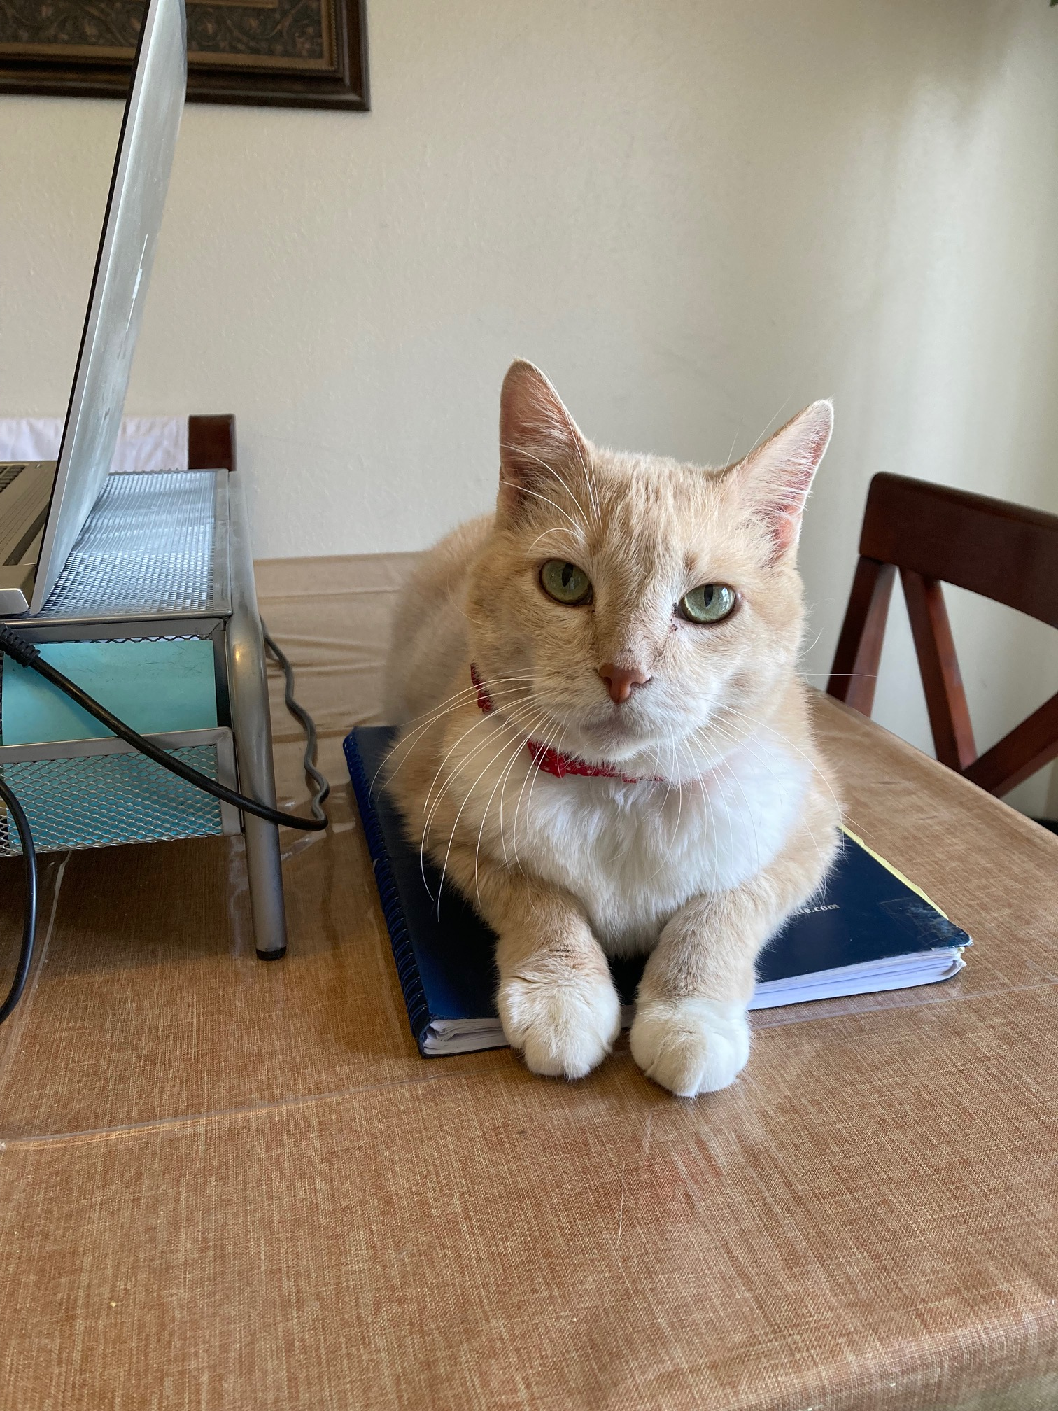
Pictures, Regs, & Applications- Oh, my!
Types of Wireless Sites
Macro-sites (cell towers)
Concealed/Camouflaged vs. Non-Concealed
Small Cells
Albuquerque’s Local Regulations
Application Management
Decisions

Slide 42
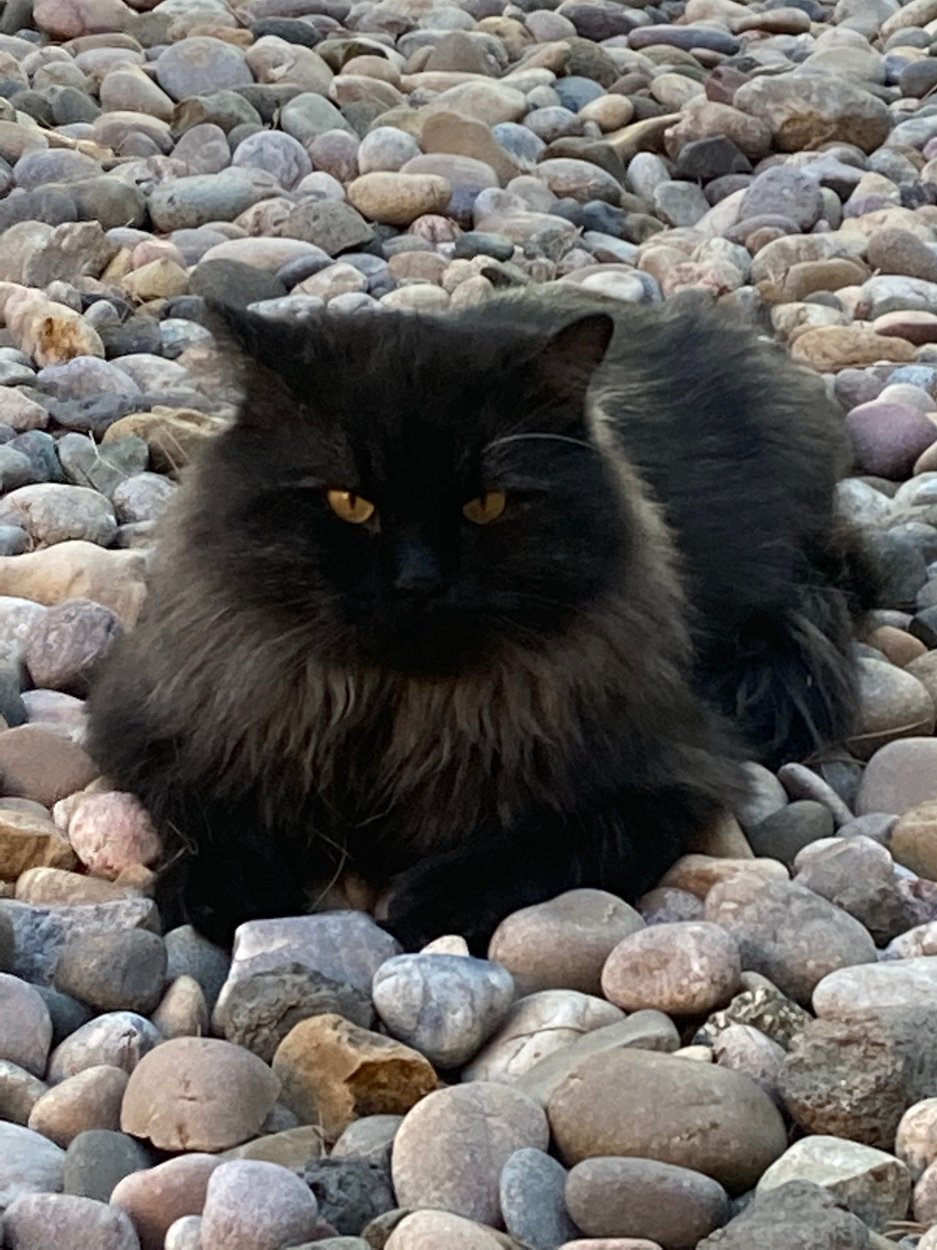
Types of WTFs… or Can I See You Now?
Basically, there are two types of macro
sites:
Non-camouflaged aka “Non-concealed”
Ex. Arrays, Lattice Towers
Camouflaged aka “Stealth” or “Concealed”
Ex. Fake trees, crosses, flag poles, building additions
Notes:
…..small cell sites are pretty new to Abq. Small cells cover about a 500 ft. radius, serve coverage and capacity, about 25 foot centerlines. Typically used to increase capacity in small areas.
DAS- we don’t have here.

Slide 43
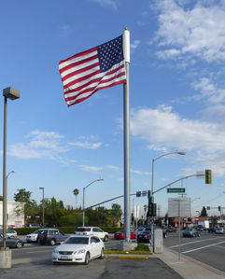
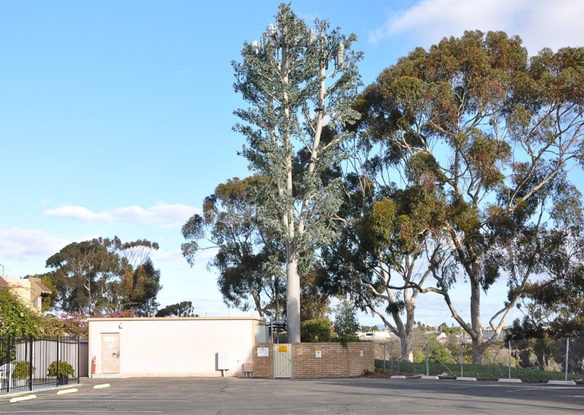
The Good, The Bad, and The Ugly- Part 1: Good=Not Awful
Sending out
The Word!
Waving the waves!
‘I think that I shall never see
A poem lovely as a mono-elm tree.’
-with apologies to Joyce Kilmer

Slide 44
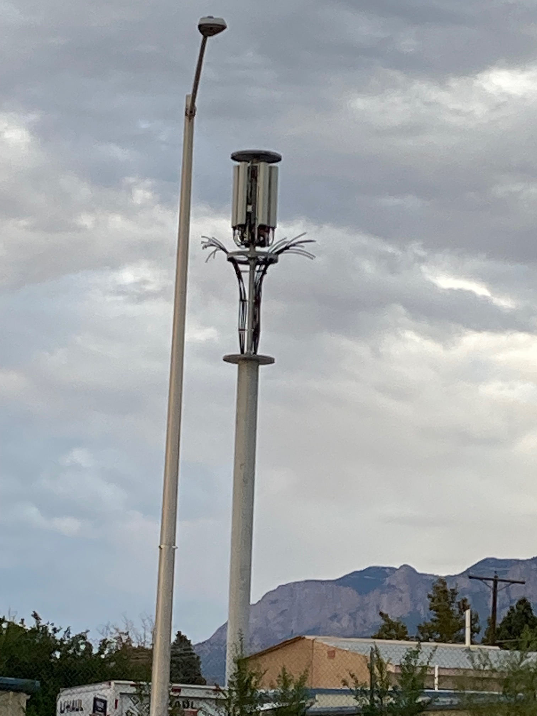
The Good, The Bad, and The Ugly- Part 2: Bad=NOT the least intrusive means, non-compliant

Slide 45
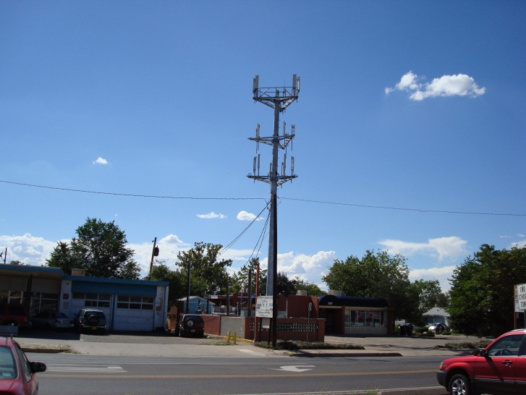
The Good, The Bad, and The Ugly- Part 3: Ugly=Ugly

Slide 46
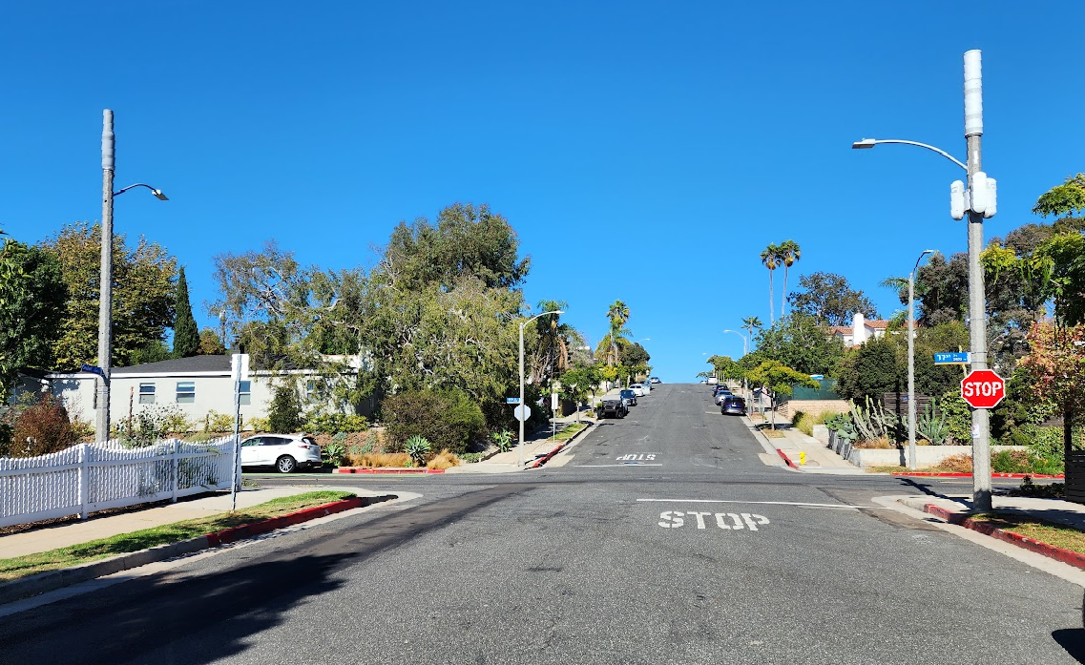
The Good, The Bad, and The Ugly- Part 3: The Future?

Slide 47
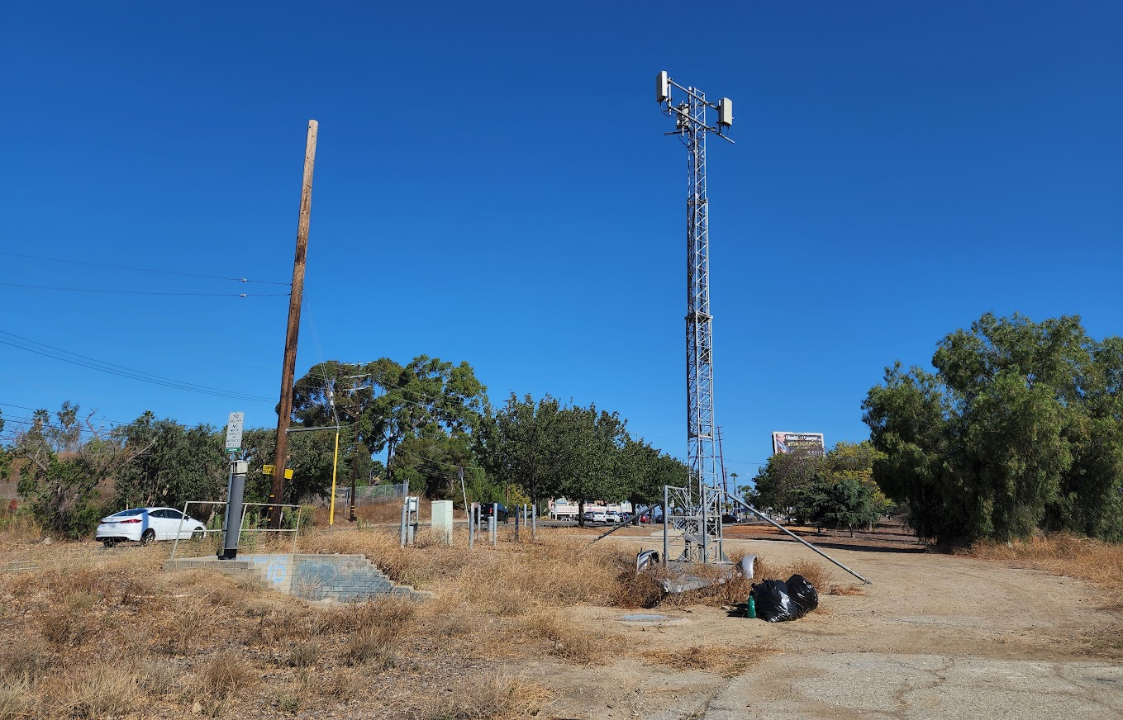
The Good, The Bad, and The Ugly- Part 3: The Future?

Slide 48
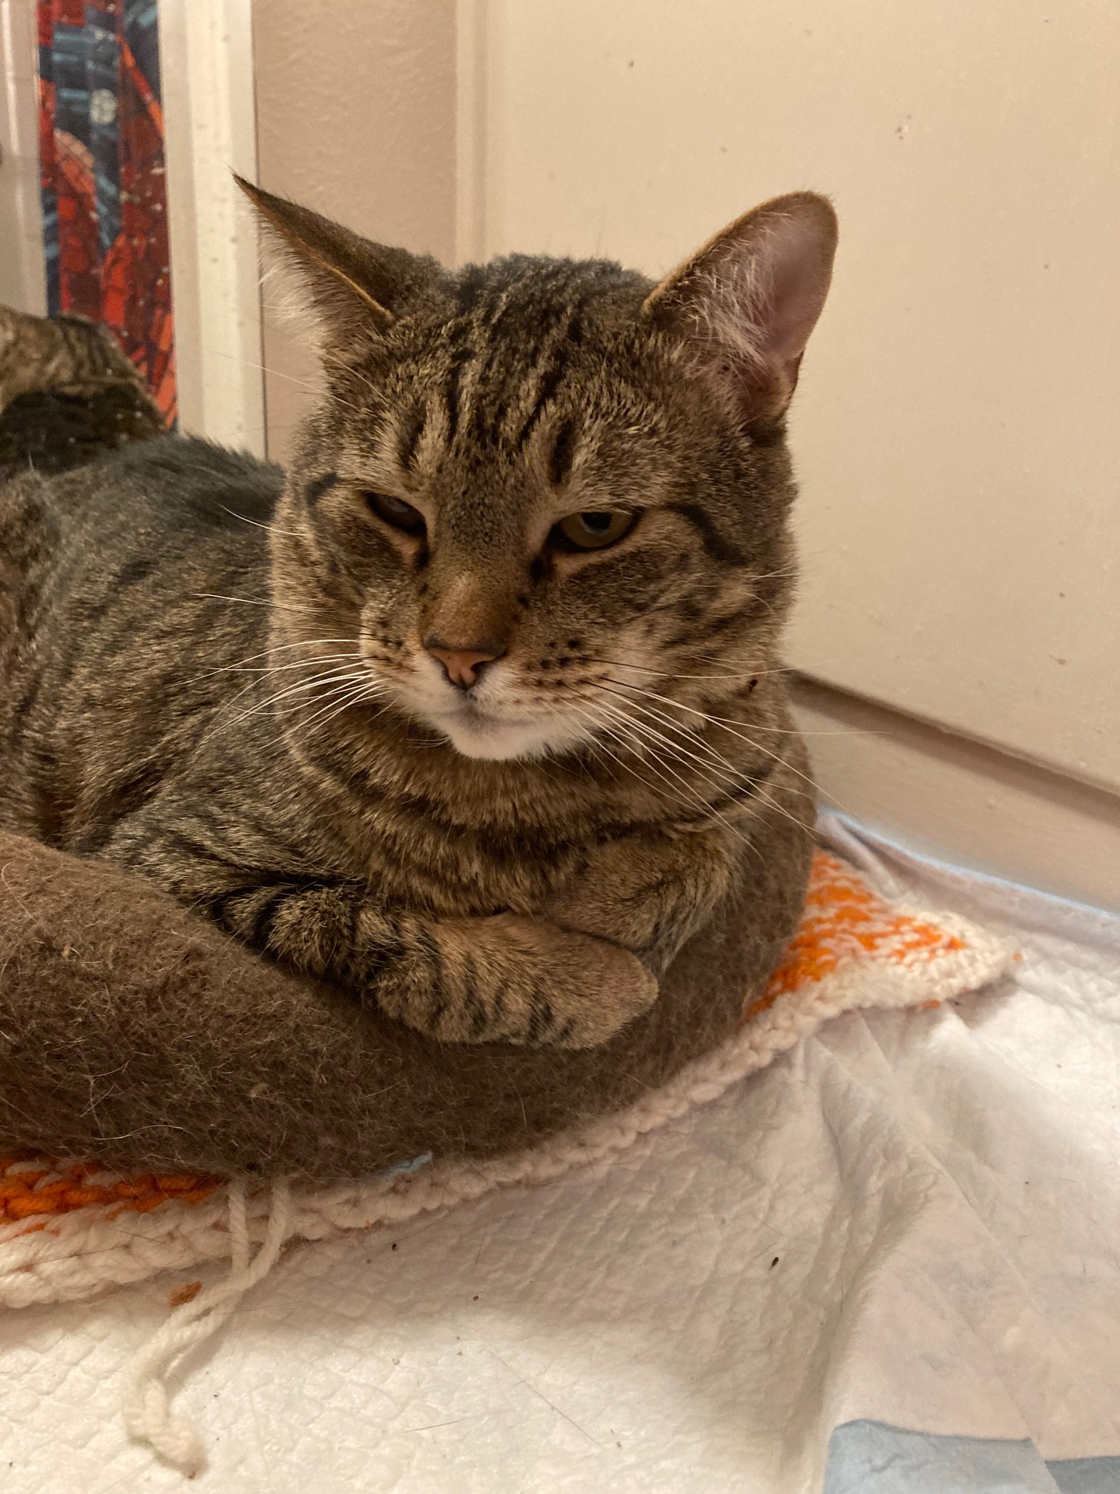
Small Wireless Facilities (SWFs)
(almost all) Located in the public ROW
Provide capacity using 4G and/or 5G technology
Cover a small area- ex. 500 feet, so many are needed
Operate using less power than macro-sites
Support the macro-site coverage layer
A key part of fixed wireless (a cable TV killer?)

Slide 49
SWF Examples
4G antennas
5G antennas
5G antennas
Replacement Light Pole SWFs

Slide 50
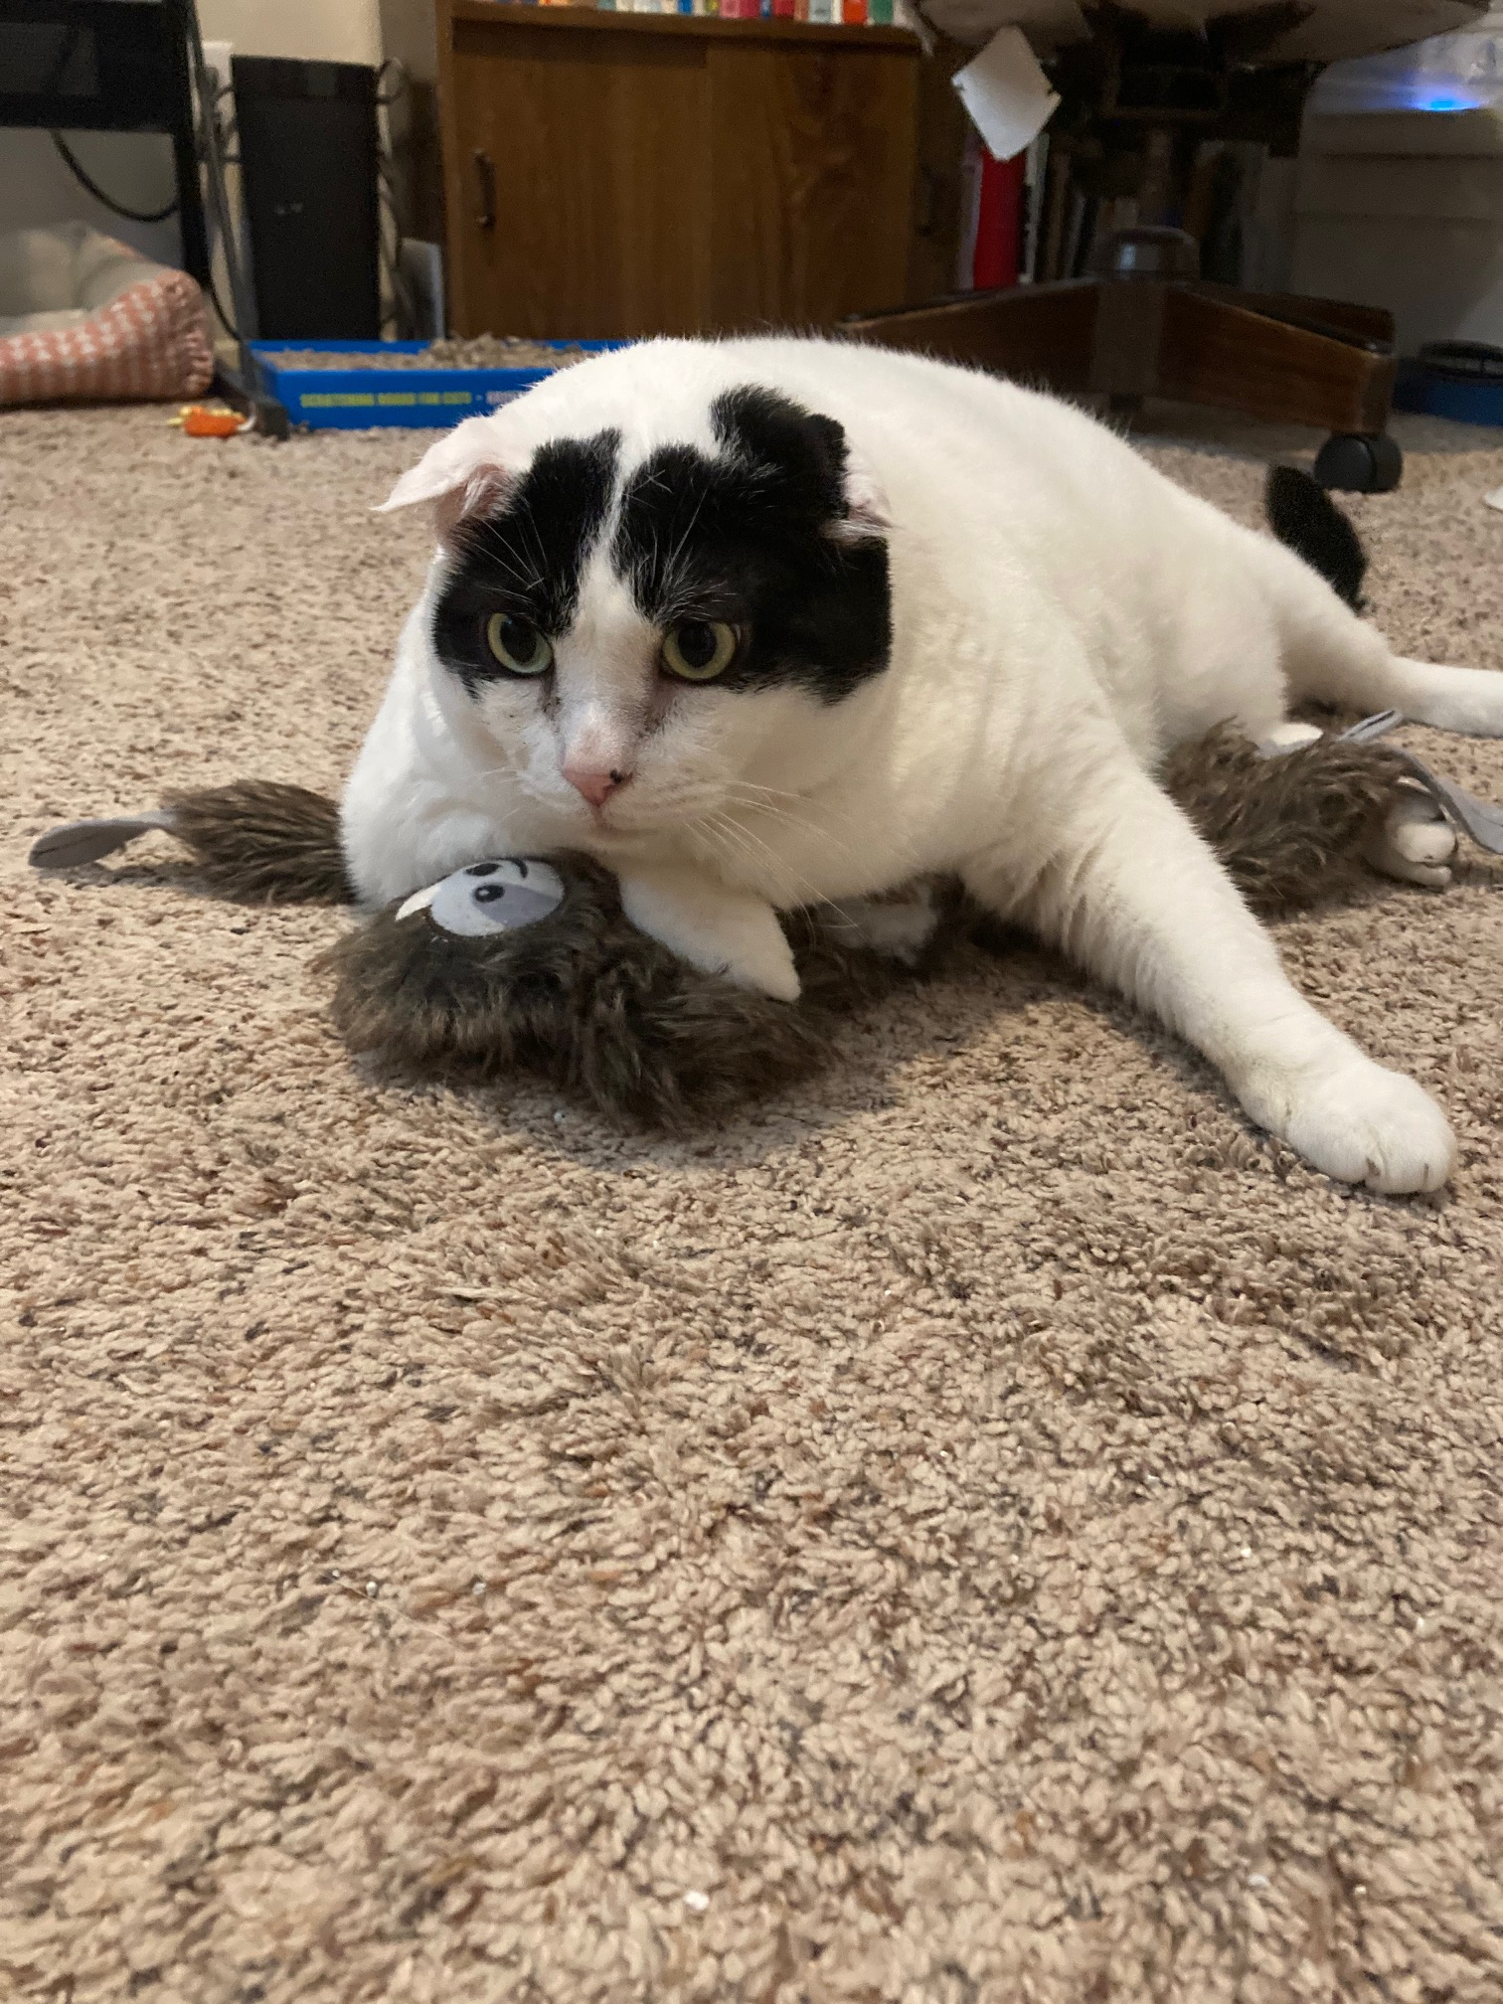
That Federal Stuff…
A basic understanding is important because….
Pre-empts local requirements
Understand it in order to follow it
Applicants often throw it around
Defensible decisions and Appeals

Slide 51
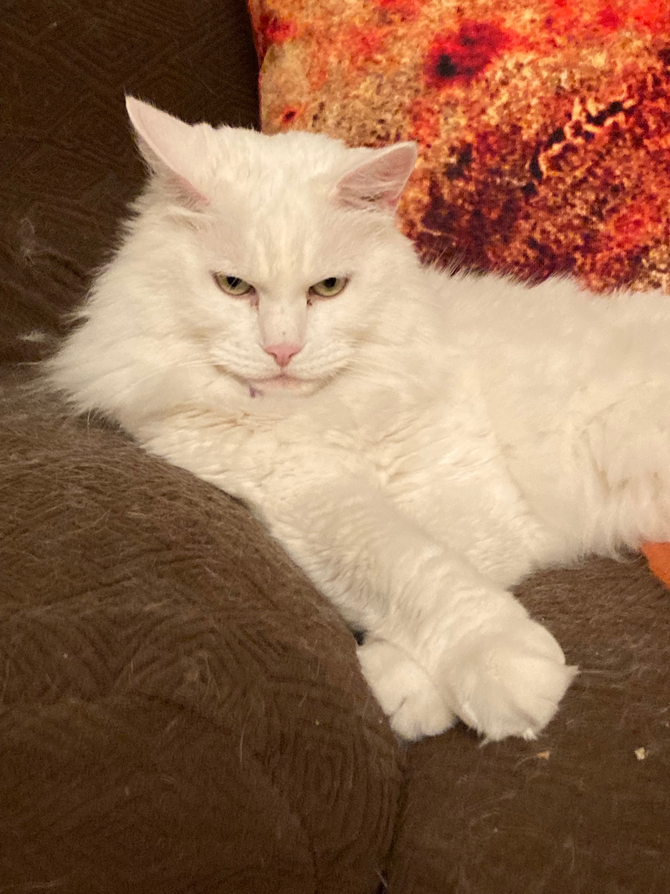
Albuquerque’s Treatment of Wireless
So, how do you deal with it?
Review Process
Application Requirements
Siting- City Application Forms
Publish! It’s an FCC requirement.
Technical- Supplemental Form
SWFs
Website https://www.cabq.gov/planning/code-enforcement-zoning/wireless-telecommunication-facilities
Notes:
The reason for this slide is that, well, you have regulations, but where do you take it from there? What’s the process for dealing with wireless requests? Review process- in Abq., all administrative, by Staff, some current planning some zoning counter depending upon what it is.

Slide 52
Issues & Challenges for Planners
Application Incompleteness
Difficult agents with limited authority
Inconsistency between what’s built and what was approved (happens surprisingly often..)
The technical “black box” (Jargon + Bluff = ??)
Appeals- prepare to be challenged!
Don’t forget the shot clocks!
Notes:
These are issues and challenges based on my experience. Of course, it’s going to be different in each jurisdiction, but I think that generally a lot of these tend to hold true.

Slide 53
Questions? (Yeah, us too…)

